Slide 1

WORKSHOP: Parallel Computing with MATLAB (Part I)
Jon Loftin, PhD
Customer Success Engineer

Slide 2
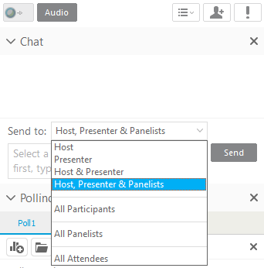

Webex Chatting
Send to at least the Host, Presenter & Panelists
Ideally, send to All Attendees
Participants

Slide 3
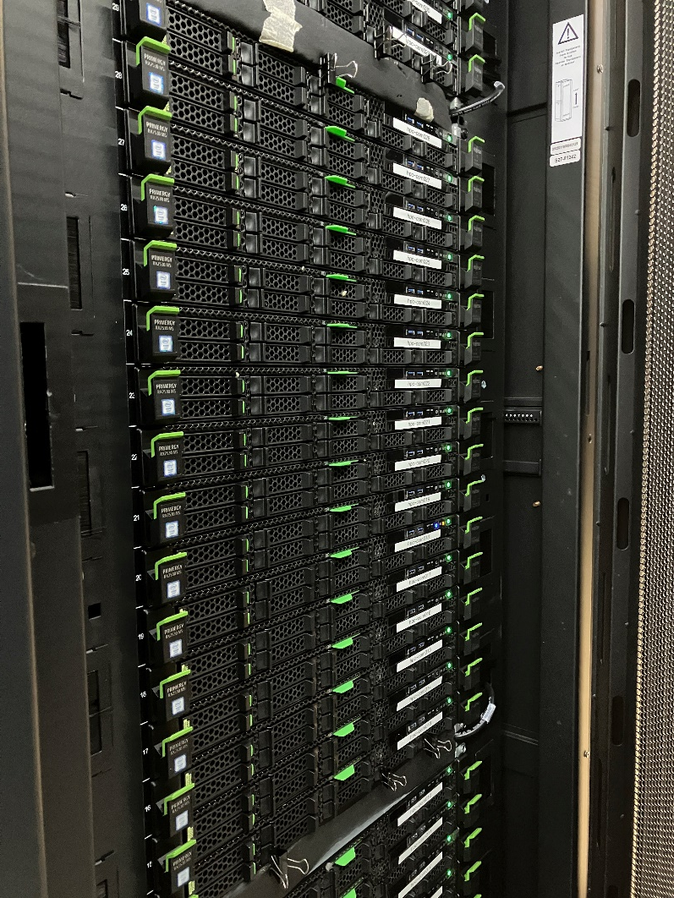
Agenda
Part I – Parallel Computing with MATLAB on the Desktop
Parallel Computing Toolbox
Part II – Scaling MATLAB to the HPC cluster
MATLAB Parallel Server

Slide 4
Agenda
Part I – Parallel Computing with MATLAB on the Desktop
Parallel Computing Toolbox
Part II – Scaling MATLAB to the HPC cluster
MATLAB Parallel Server

Slide 5

Why use parallel computing?
Save time with parallel computing by carrying out computationally and data-intensive problems in parallel (simultaneously)
distribute your tasks to be executed in parallel
distribute your data to solve big data problems
on your compute cores and GPUs or scaled up to clusters and cloud computing
Notes:
What is PC and why do you need it?
As the problems we need to solve are getting larger and more complex, and your hardware is becoming more powerful, there is a need to save time by taking advantage of your desktop computer resources, your clusters and clouds.
Parallel computing allows you to carry out many calculations simultaneously. Large problems can often be split into smaller ones, which are then solved at the same time.
You can
Save time by distributing tasks and executing these simultaneously
Solve big data problems by distributing data

Slide 6
Why use parallel computing with MATLAB?
Save time with parallel computing by carrying out computationally and data-intensive problems in parallel (simultaneously)
distribute your tasks to be executed in parallel
distribute your data to solve big data problems
on your compute cores and GPUs or scaled up to clusters and cloud computing with minimal code changes, so you can focus on your research
Core 1
Core 2
Core 3
Core 4
CPU with 4 cores
Notes:
Our overall goal is to reduce the amount of time it takes complete computation. We can do that by throwing more resources at it, scaling to clusters and clouds and using additional resources like GPUs.
However, the challenge lies in the fact that you need software to utilize the power of this hardware and hence parallel computing expertise is a requirement. So, we also want to make this process as easy as possible. It doesn’t matter if your code runs twice as fast on the cluster if it takes you three times as long to re-write the code. We want to make it easy to use parallel computing so that you can focus on your research, not the computation itself.

Slide 7
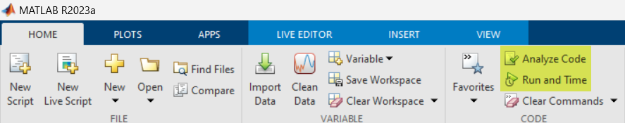
Before going parallel, optimize your code for the best performance

Slide 8
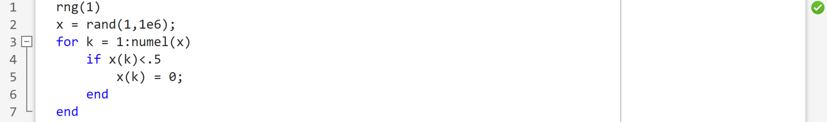
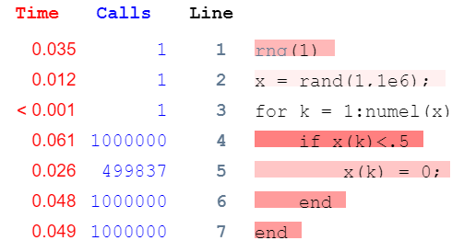
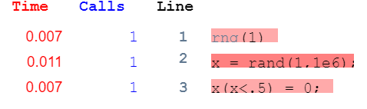
Before going parallel, optimize your code for the best performance
Use the Profiler to find the code that runs slowest and determine possible performance improvements
Use vectorization (matrix and vector operations)
instead of for-loops
Notes:
When the Code Analyzer does no longer help, MATLAB contains a profiler that can look at your code, measure it time it takes to run it, and identify which sections take the most time. From there, you can then evaluate the different sections to see where speed-up might be possible. You can continuously return to the profiler as you make changes to see that improvement over time.

Slide 9
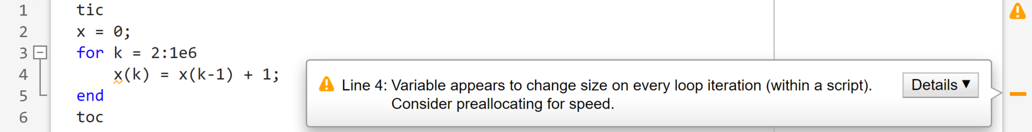
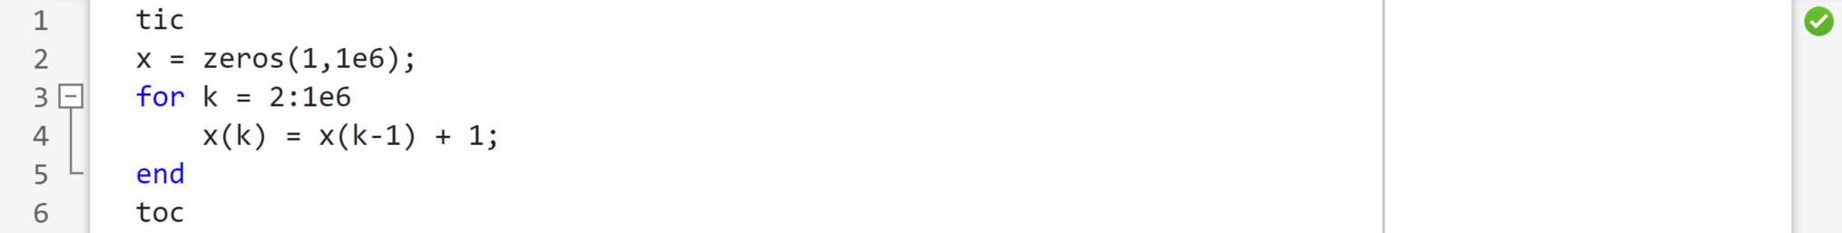
Before going parallel, optimize your code for the best performance
Use the Code Analyzer to automatically check your code for coding (and performance) problems
Elapsed time is 0.075824 seconds.
Preallocate the maximum amount of space required for the array instead of letting MATLAB repeatedly reallocate memory for the growing array
Elapsed time is 0.013109 seconds.
Notes:
Before we think about scaling our code to a cluster, we need to make sure that it’s optimized as fully as possible. Inefficient code on your desktop is still going to be inefficient on the cluster, regardless of how much resources you throw at it. *CLICK*
For instance, you can use the MATLAB® Code Analyzer to automatically check your code for coding problems. You can view warning and error messages about your code, and modify your file based on the messages. CLICK
Let’s have a look at this piece of code (explain). The problem: Numeric/char arrays are stored in a continuous block of memory. Problem: Using a loop to incrementally add new elements to an existing array can affect:
performance: MATLAB might spend extra time looking for a larger contiguous block, and then moving the array into the block.
memory use: this temporarily doubles the amount of memory required for the array and may lead to out-of-memory issues.
Solution: Preallocate the maximum amount of space required for the array instead of letting MATLAB repeatedly reallocate memory for the growing array:
When you modify your code, the messages are updated automatically and continuously so you can see if your changes address the issues noted in the messages. Notice the performance improvement as well.

Slide 10
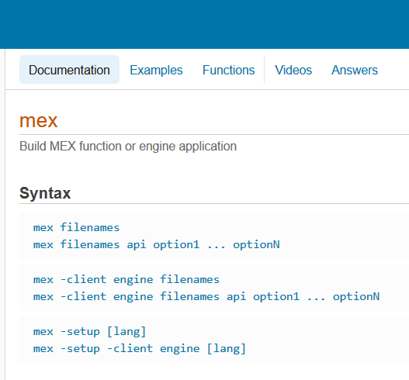
Before going parallel, optimize your code for the best performance
Replace code with MEX functions
Techniques for accelerating MATLAB algorithms and applications

Slide 11
Before going parallel, optimize your code for the best performance with efficient programming practices
Try using functions instead of scripts. Functions are generally faster
Pre-allocate memory instead of letting arrays be resized dynamically
Create a new variable rather than assigning data of a different type to an existing variable
Vectorize – Use matrix and vector operations instead of for-loops
Avoid printing too much data on the screen, reuse existing graphics handles
Place independent operations outside loops to avoid redundant computations
Techniques to improve performance
Notes:
Preallocate — Instead of continuously resizing arrays, consider preallocating the maximum amount of space required for an array. For more information, see Preallocation.
Vectorize — Instead of writing loop-based code, consider using MATLAB matrix and vector operations. For more information, see Vectorization.
Prefer local functions over nested functions. Use this practice especially if the function does not need to access variables in the main function.
Create new variables if data type changes — Create a new variable rather than assigning data of a different type to an existing variable. Changing the class or array shape of an existing variable takes extra time to process.
Place independent operations outside loops — If code does not evaluate differently with each for or while loop iteration, move it outside of the loop to avoid redundant computations.

Slide 12
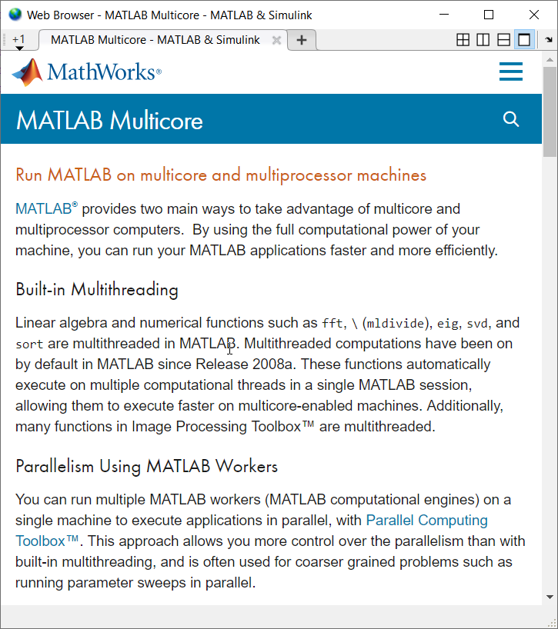


MATLAB has built-in multithreading
Multi-core CPU
MATLAB
MATLAB multicore
Notes:
It’s important to note that even without Parallel Computing Toolbox, [click] MATLAB provides implicit multi-core support with its built–in multithreading. A growing number of core MATLAB functions take advantage of underlying multi-threaded library support, and other toolboxes leverage those benefits when they use core MATLAB functions. However, not every MATLAB function is able to be multi-threaded, and any acceleration is limited to your local workstation.
*next*

Slide 13

Scale further with parallel computing
Multi-core CPU
MATLAB
Parallel Computing Toolbox
MATLAB multicore
Notes:
Therefore, parallel computing tools enable you to receive benefits beyond these limitations.
Put another way, Parallel Computing Toolbox enables direct control of your parallel resources. For example, parallel constructs like parfor let you control which portions of your workflow are distributed to multiple cores. Later on, we’ll talk about how you can extend that level of control to resources on compute clusters by using MATLAB Parallel Server.
*next*

Slide 14
Run parallel code by utilizing multiple CPU cores
parallel pool
MATLAB Client
(your MATLAB session)
Parallel Computing Toolbox
workers
(Computational engines that run in the background without a graphical desktop)
Notes:
Those of you licensed to use Parallel Computing Toolbox will install it alongside MATLAB; we will use the term "MATLAB Client" to refer to the machine with the Toolbox installed. The Toolbox will allow you to be more productive with your multicore processors by utilizing MATLAB computational engines called workers. These workers are controlled by your MATLAB session and allow you to use the full potential of your hardware to speed up your workflow. You can use workers interactively or send work for them to run in the background.
Workers form the basis for CPU-based parallel workflows. When you have a collection of workers with inter-process communication, we call that a “parallel pool.” You can initialize and manage a parallel pool "programmatically" -- using MATLAB code -- or "interactively" -- from this icon in the MATLAB Desktop Environment. Parallel Computing Toolbox handles the work involved in dividing up tasks and computations and assigning them to workers in the parallel pool, thereby enabling your resources to perform parallel computing.
The behind-the-scenes work is all encapsulated in easy-to-use syntax, sometimes as simple as just changing one word, and you never have to leave the familiarity of the MATLAB desktop environment.
In general, you should not run more MATLAB workers [previous: computational engines] than the number of physical cores available to your machine; otherwise, you are likely to have resource contention.
*next*

Slide 15
Download instructions
https://tinyurl.com/ParallelComputingWorkshop
Click on Add to my Files
Click Copy Folder’

Slide 16
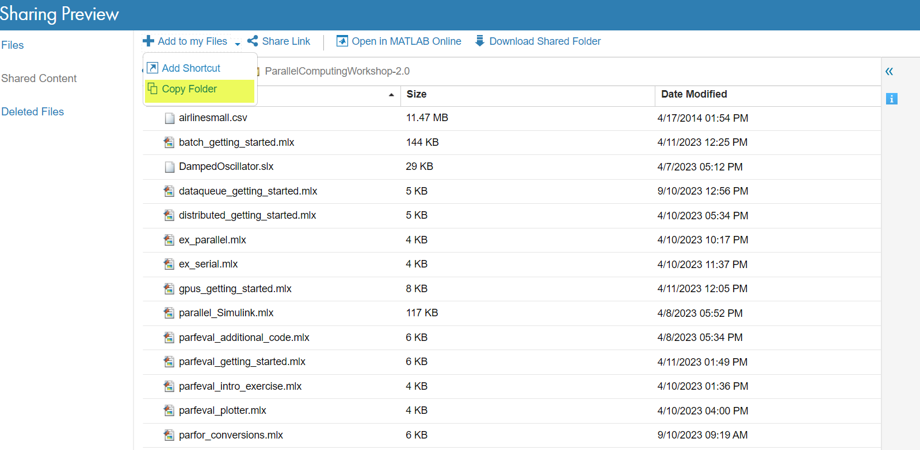
Setup: Step 1 – Copy materials via MATLAB Drive
Click Add to my Files and then click Copy Folder.
For use on your MATLAB Desktop, click Download Shared Folder instead.
https://tinyurl.com/ParallelComputingWorkshop

Slide 17
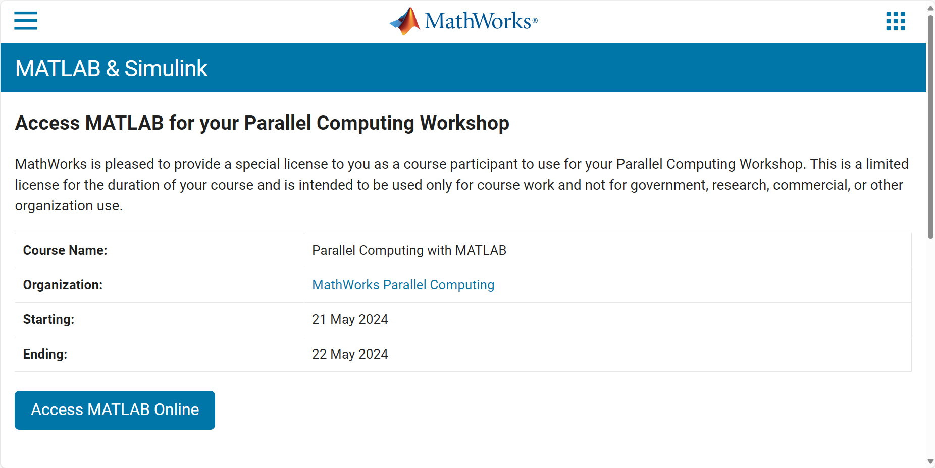
Setup: Step 2 – Launch MATLAB Online​

Slide 18
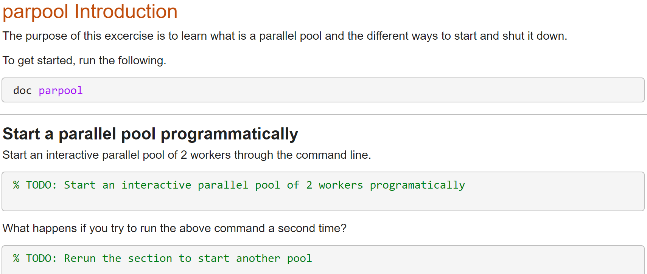
Hands-On Exercise: Starting a parallel pool
parpool_intro

Slide 19
Scaling MATLAB applications and Simulink simulations
 | Automatic parallel support in toolboxes
 | Common programming constructs
 | Advanced programming constructs
Ease of Use
Greater Control
Notes:
Now that we’ve covered the basics, let’s start with the easiest-to-use, and work our way down.
Some parallel constructs in MATLAB are easier to get started with, but offer less control. This includes automatic parallel support in certain toolboxes, where it could be as simple as passing a flag to enable parallel features
*next*

Slide 20
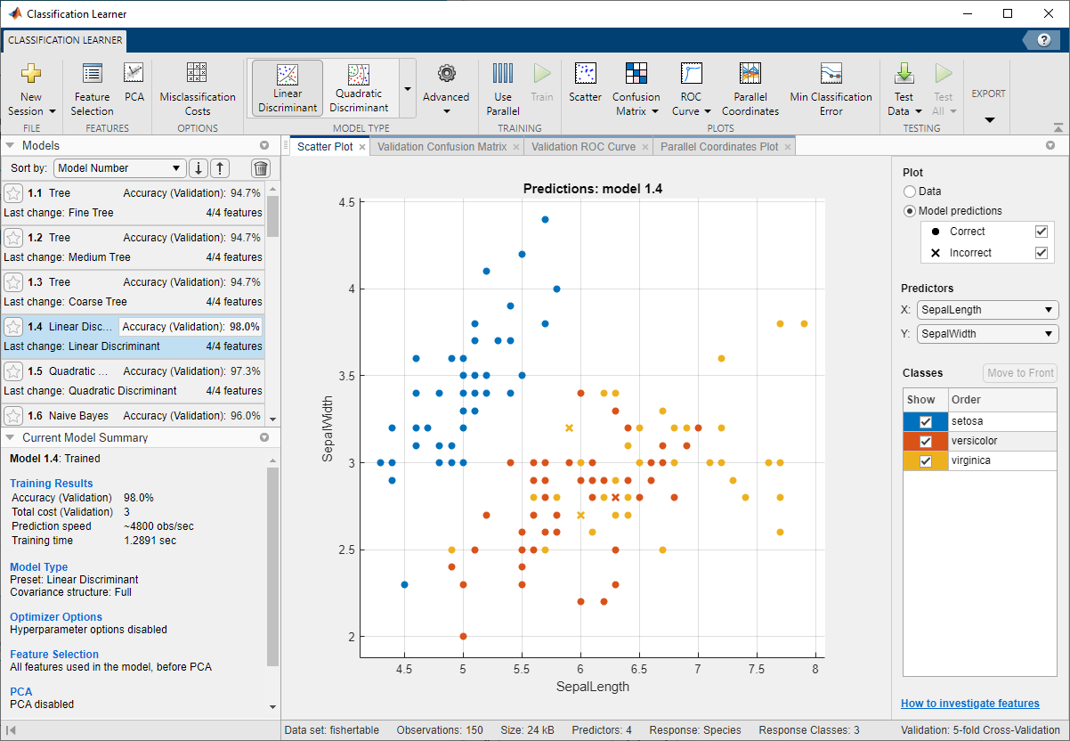
Automatic parallel support in toolboxes

Slide 21
Scaling MATLAB applications and Simulink simulations
 | Automatic parallel support in toolboxes
 | Common programming constructs (parfor, parfeval, parsim, …)
 | Advanced programming constructs
Ease of Use
Greater Control
Notes:
Others require more knowledge of parallel computing, but offer more granular control such as parfor and parsim. If your bottleneck does not involve a function with automatic parallel support, there are plenty of parallel constructs available in MATLAB that give you more control over what and how something is parallelized.
The Parallel Computing team at MathWorks is actively adding more constructs and improving existing ones.
*next*

Slide 22


Run independent iterations in parallel using parfor Use cases: Parameter sweeps and Monte Carlo simulations
MATLAB
Workers
a = zeros(5, 1);
b = pi;
for i = 1:5
a(i) = i + b;
end
disp(a)
a = zeros(5, 1);
b = pi;
parfor i = 1:5
a(i) = i + b;
end
disp(a)

Slide 23
Parallelize for loops with independent iterations
MATLAB
Workers
a = zeros(10, 1);
b = pi;
parfor i = 1:10
a(i) = i + b;
end
disp(a)
Notes:
The following illustration will give you more insight into what happens when parfor executes.
[click] In this example, MATLAB has access to 3 workers. They are assigned tasks to run and once a worker has finished its current task, it can be assigned additional work.
Finally, the results are collected, and can be displayed in MATLAB.

Slide 24
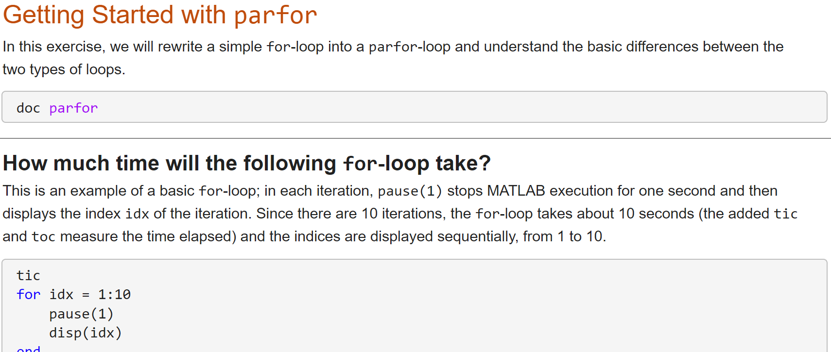
Hands-On Exercise: Writing our first parfor
parfor_getting_started

Slide 25
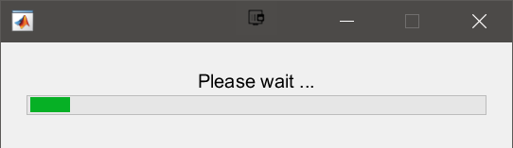
DataQueue: Execute code as parfor iterations complete
function a = parforWaitbar
h = waitbar(0, 'Please wait ...');
D = parallel.pool.DataQueue;
afterEach(D, @nUpdateWaitbar)
N = 200;
p = 1;
parfor i = 1:N
a(i) = max(abs(eig(rand(400))));
send(D, i)
end
function nUpdateWaitbar(~)
waitbar(p/N, h)
p = p + 1;
end
end
Send data or messages from parallel workers back to the MATLAB client
Retrieve intermediate values and track computation progress
Notes:
A DataQueue enables asynchronous sending data or messages from workers back to the client in a parallel pool while a computation is carried out. For example, you can get intermediate values and an indication of the progress of the computation. One useful application of this is being able to view the progress of your parallel computation.
[click] To get started, we construct the [click] dataqueue and create a [click] waitbar which we will use to view our progress. We then specify [click] what action will take place every time a worker triggers the dataqueue. In this case, we want to run a function, nUpdateWaitbar, which will update the waitbar. We use the afterEach construct to trigger the nUpdateWaitbar function after [click] each iteration in the parfor, as indicated by the send construct. You can also use afterEach with parfeval.
As the parfor-loop runs, the workers notify the client after their calculation has finished. This triggers the [click] nUpdateWaitbar function, which updates the indicated progress of the parallel workers.
[click] The key components of this workflow, are
• dataQueue
• afterEach
• send
• and the function you provide to run after each iteration.
*next*

Slide 26
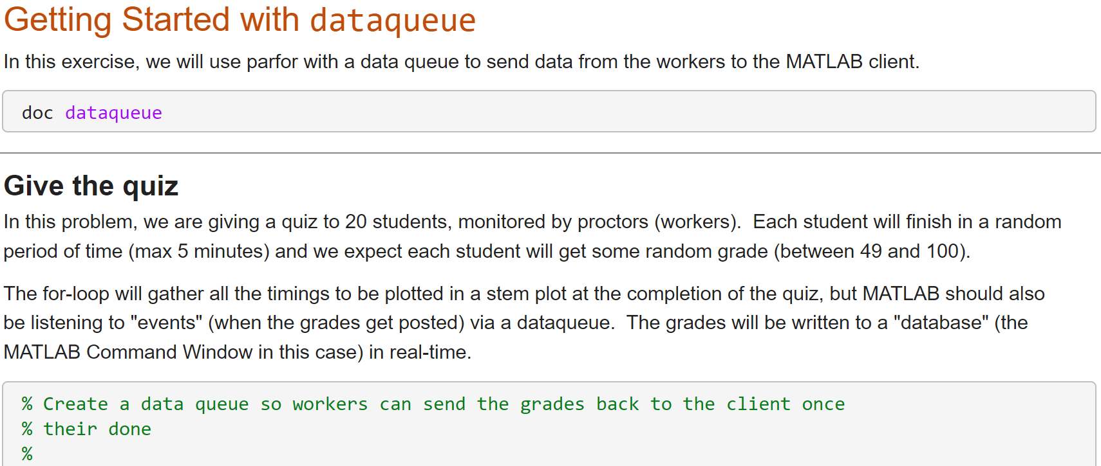
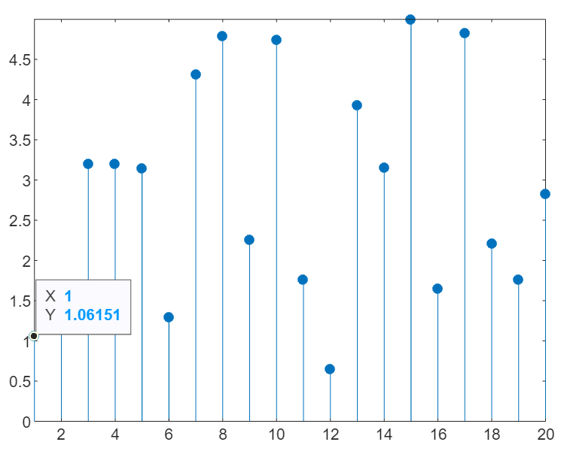
Hands-On Exercise: Sending data with a dataqueue
dataqueue_getting_started

Slide 27

Execute functions in parallel asynchronously using parfeval
Workers
fetchNext
Outputs
MATLAB
for idx = 1:10
f(idx) = parfeval(@monteCarloSim,1,idx);
end
for idx = 1:10
[completedIdx, value] = fetchNext(f);
if value>0.95
f.cancel
break
else
mcs(completedIdx) = value;
end
end
Asynchronous execution on parallel workers
Useful for “needle in a haystack” problems
Notes:
Another common parallel construct is parfeval, short for parallel feval. This parallel construct is similar to parfor-loops, because it utilizes parallel workers to run multiple tasks in parallel. The difference is, it operates only on functions and it is asynchronous, or non-blocking with respect to MATLAB. Unlike parfor-loops, parfeval allows you to continue executing commands in MATLAB while the parallel work completes in the background. If you do not have Parallel Computing Toolbox, parfeval will run in serial.
[click] parfeval creates a queue of tasks that each execute a function on a parallel worker. The queue is such that the next item in the queue is always executed on the next available worker in the pool, thereby preserving order of execution.
After tasks are queued up for execution, you are free to use MATLAB on other tasks without having to wait on the queued tasks. When they are done, you can retrieve results of the computation using fetchNext. You can also add or delete tasks from the queue. As you pull results, if you find the result you are looking for, you can cancel the remainder of the queue and stop the computation.
Parfeval also distributes work to the parallel workers in a different manner than parfor. As you saw, instead of transferring groups of tasks to the parallel workers, parfeval transfers one task at a time. If your tasks or iterations have significantly different runtimes, parfeval will help avoid idle workers that can be caused by grouping tasks.
That being said, parfor will still most likely be your go-to solution, but keep parfeval in mind if you need to preserve the order of execution, if you need a parallel queue, or if you would like to keep using MATLAB, while it performs computations in the background.
*next*

Slide 28
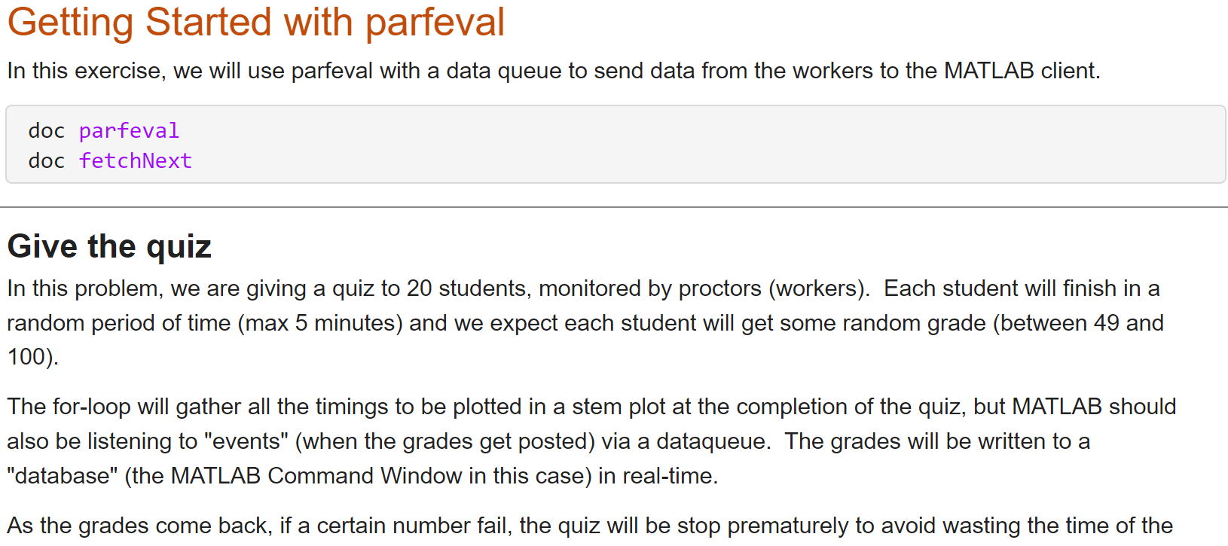
Hands-On Exercise: Sending data with a dataqueue v2
parfeval_getting_started

Slide 29
Run code in parallel
Synchronously with parfor
You wait for your loop to complete to obtain your results
Your MATLAB client is blocked from running any new computations
You cannot break out of loop early
Asynchronously with parfeval
You can obtain intermediate results
Your MATLAB client is free to run other computations
You can terminate execution early
Notes:
Another common parallel construct is parfeval, short for parallel feval. This parallel construct is similar to parfor-loops, because it utilizes parallel workers to run multiple tasks in parallel. The difference is, it operates only on functions and it is asynchronous, or non-blocking with respect to MATLAB. Unlike parfor-loops, parfeval allows you to continue executing commands in MATLAB while the parallel work completes in the background.

Slide 30
Leverage NVIDIA GPUs without learning CUDA
MATLAB client
or worker
GPU cores
Device Memory
Notes:
Using a pool of MATLAB Workers to distribute your computations is not the only way you can take advantage of parallel computing. Our parallel computing tools have made it extremely easy to speed up your computations using GPUs as well. We support NVIDIA cards with a compute capability of 2.0 or greater
The parallel computing paradigm for GPUs is different from the that for CPUs. GPUs have hundreds or even thousands of cores, but we treat the entire GPU as one unit that can be fully accessed by one MATLAB computational engine at a time.
Expected speed-up varies with problem specifics as well as the avaialable hardware.

Slide 31
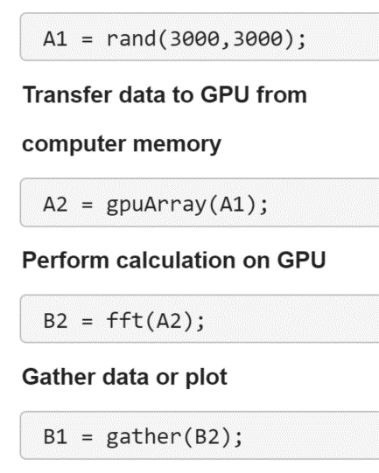
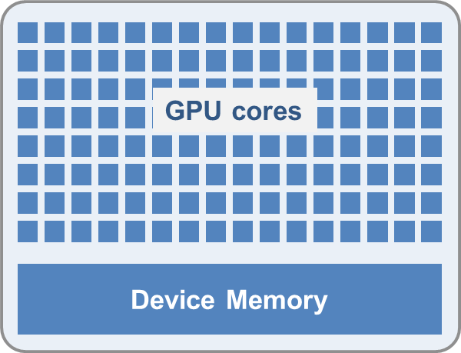
Leverage your GPU to accelerate your MATLAB code​
Ideal Problems
massively parallel and/or vectorized operations
computationally intensive
1000+ GPU-supported functions
Use gpuArray and gather to transfer data between CPU and GPU
MATLAB GPU Computing
Notes:
Not all problems are suited for the GPU. Ideal problems for GPU computing are massively parallel, and/or computationally intensive.
1. Massively parallel—means that the computations can be broken down into hundreds or thousands of independent units of work. You will see the best performance when all of the cores are kept busy, exploiting the inherent parallel nature of the GPU.
2. Computationally intensive—means that the time spent on computation significantly exceeds the time spent on transferring data to and from GPU memory. GPUs have a high speed memory bus for data transfer within the GPU. However, the GPU has to use the much slower PCI Express bus to communicate with the CPU. This means that your overall computational speedup will be reduced by the amount of time it takes to transfer data between devices as required for your algorithm.
MathWorks developers have written CUDA versions of key MATLAB and toolbox functions, which are presented as overloaded functions. The GPU version of a function will run when the input is in GPU memory. In the example to the right, [click] we initially create a matrix on the CPU. Using [click] gpuArray, we send a copy of that matrix to the GPU. [click] We then execute an fft function on that matrix, and note that even though there is no explicit instruction to use a GPU, MATLAB will see that the matrix resides on the GPU, and will use the GPU instead of the CPU to perform the computation. This means that you can use your GPU for faster computation while still using the same underlying code. After the computation is complete, [click] you can gather the results and view them in MATLAB as normal.
You can further accelerate your code using advanced GPU CUDA and MEX programming. You can learn more by consulting product documentation and technical support.
*next*

Slide 32
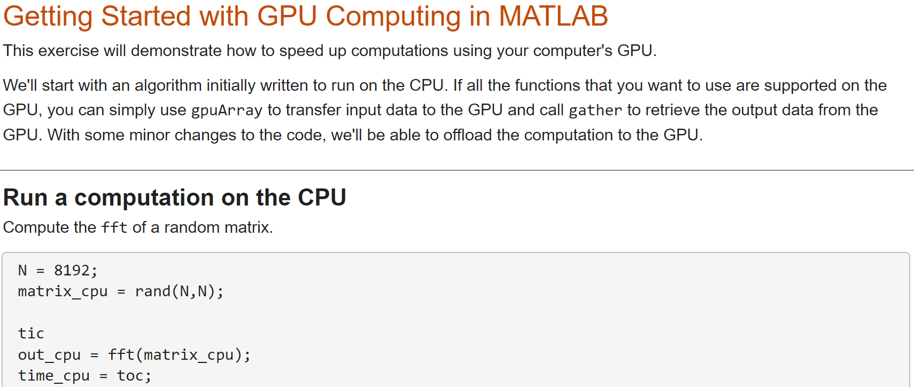
Hands-On Exercise: Offload computations to your GPU
gpus_getting_started

Slide 33
Scaling MATLAB applications and Simulink simulations
 | Automatic parallel support in toolboxes
 | Common programming constructs
 | Advanced programming constructs (spmd,etc.)
Ease of Use
Greater Control
Notes:
At this point, we’ve talked about automatic parallel support, and common programming constructs. Parallel Computing Toolbox also offers advanced parallel constructs for the most control of your resources, such as
• configuring parallel workers to communicate with one another and pass data
• splitting large matrices across the memory of multiple machines
• and working with large repositories of data.
Since these topics may not have broad appeal, if you’d like to learn more, you can check out the resources at the end of this presentation. Product documentation and technical support can also help you with your questions.
*next*

Slide 34
Got More Time? . . .

Slide 35
Troubleshooting . . .

Slide 36
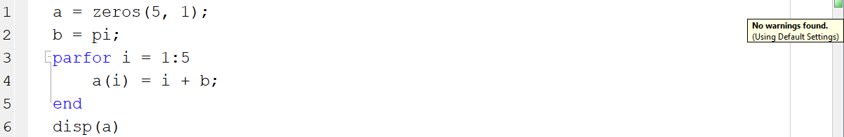
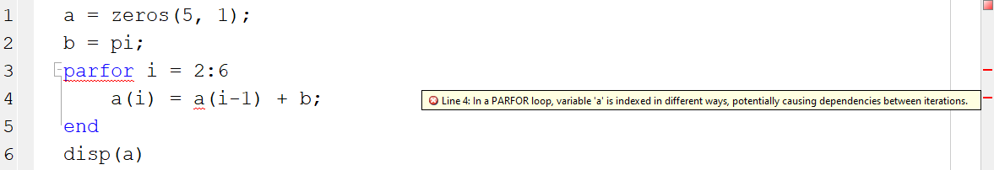
Use Code Analyzer to fix problems when converting for-loops to parfor-loops
parfor-loop iterations have no guaranteed order, and one loop iteration cannot depend on a previous iteration; therefore, you may need to rewrite your code to use parfor
Notes:
When changing for to parfor, you may need to make some adjustments to your code. The Code Analyzer will help to guide you through this process by informing you of what changes need to be made in order to run the parfor-loop.
In this example, no warnings are displayed, and no additional code changes are needed. [click] In the second example, with slightly different code, the code analyser determines that there is an issue and brings it to our attention.
This is where I’d like to pause and mention a key consideration when using parfor – since each iteration is computed completely independently, there is no guarantee of the iterations occurring in any particular order. For this reason, your loop cannot rely on the results from a different iteration. It must be able to stand alone. In the example above, the variable “a” is indexed in such a manner that could cause dependencies between iterations, causing the error and preventing the parfor from running.
*next*

Slide 37
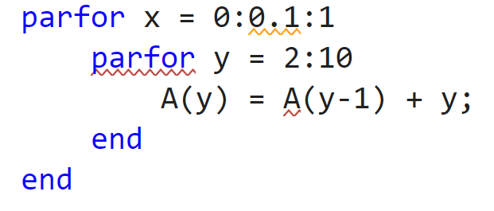
Common problems when rewriting a for-loop as a parfor-loop
Noninteger loop variables
Nested parallel loops
Dependent loop body
Notes:
In some cases, you must modify the code to convert for-loops to parfor-loops. To solve these problems, you must modify the code to use parfor. The body of the parfor-loop is executed in a parallel pool using multiple MATLAB workers in a nondeterministic order. Therefore, you have to meet these requirements for the body of the parfor-loop:
The body of the parfor-loop must be independent. One loop iteration cannot depend on a previous iteration, because the iterations are executed in parallel in a nondeterministic order. In the example,
A(y) = A(y-1) + y;
is not independent, and therefore you cannot use parfor. For next steps in dealing with independence issues, see Ensure That parfor-Loop Iterations are Independent.
You cannot nest a parfor-loop inside another parfor-loop. The example has two nested for-loops, and therefore you can replace only one for-loop with a parfor-loop. Instead, you can call a function that uses a parfor-loop inside the body of the other parfor-loop. However, such nested parfor-loops give you no computational benefit, because all workers are used to parallelize the outermost loop. For help dealing with nested loops, see Nested parfor and for-Loops and Other parfor Requirements.
parfor-loop variables must be consecutive increasing integers. In the example,
parfor x = 0:0.1:1
has non-integer loop variables, and therefore you cannot use parfor here. You can solve this problem by changing the value of the loop variable to integer values required by the algorithm. For next steps in troubleshooting parfor-loop variables, see Ensure That parfor-Loop Variables Are Consecutive Increasing Integers.
You cannot break out of a parfor-loop early, as you can in a for-loop. Do not include a return or break statement in the body of your parfor-loop. Without communication, the other MATLAB instances running the loop do not know when to stop. As an alternative, consider parfeval.
If you still have problems converting for-loops to parfor-loops, see Troubleshoot Variables in parfor-Loops.

Slide 38
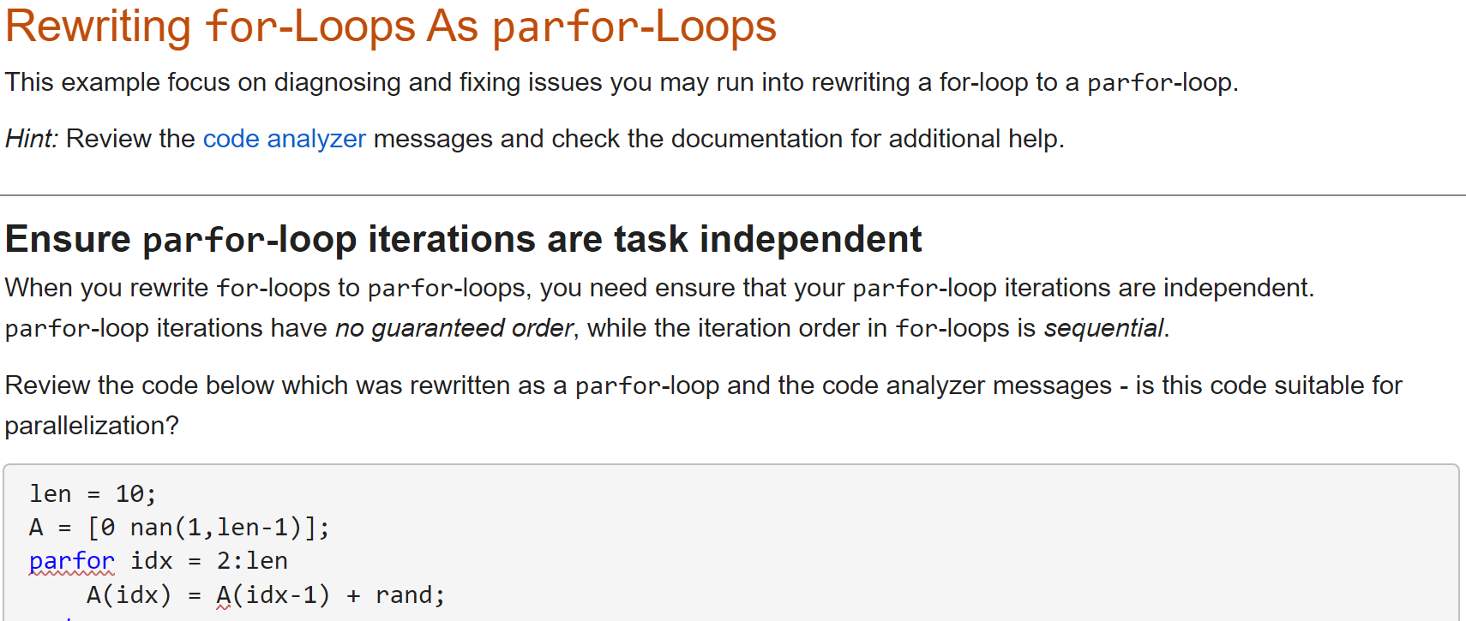
Hands-On Exercise: Rewrite for-loops into parfor-loops
parfor_conversions

Slide 39
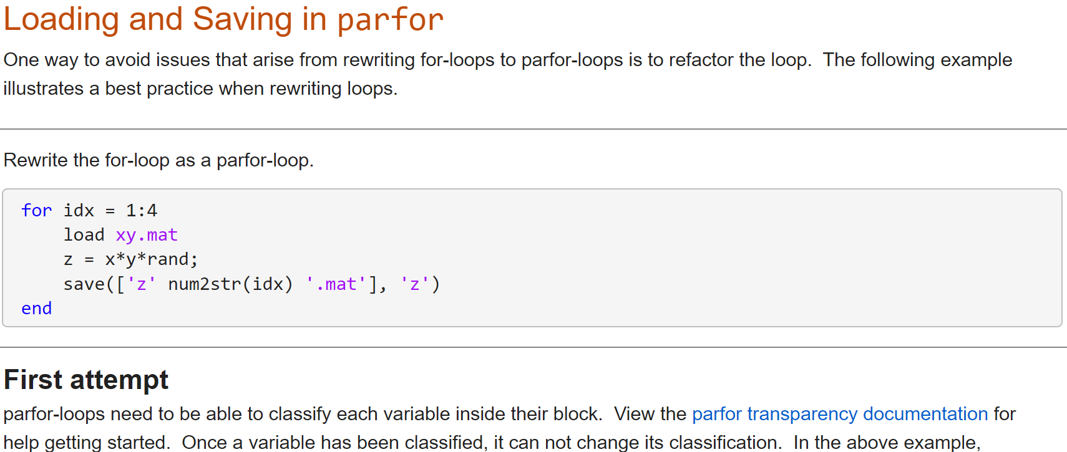
Hands-On Exercise: Refactoring for-loops
parfor_refactoring

Slide 40
Simulink . . .

Slide 41

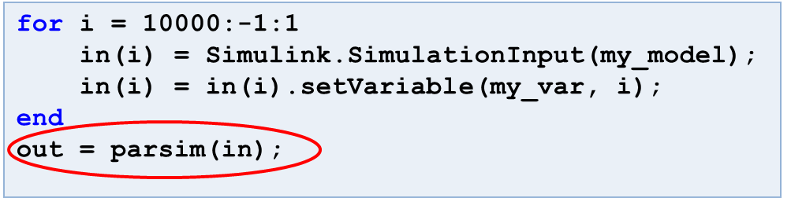
Run multiple Simulink simulations in parallel with parsim
Workers
Time
Time
Run independent Simulink simulations in parallel using the parsim function
Notes:
While you can technically use parfor within Simulink, parfor was designed primarily for MATLAB and is not recommended to be used with Simulink. Instead, use parsim to run multiple simulations in parallel.
parsim distributes multiple simulations to multicore CPUs to speed up overall simulation time. It automates the creation of parallel pools, identifies file dependencies, and manages build artifacts. It also works in conjunction with the new SimulationInput object [I talked with Weiwu about this…”sim-t” is not a thing], which helps you set up all your simulation inputs in a convenient way, including variables, block parameters, and simulation configurations [need a visual for this]
*next*

Slide 42
Clusters . . .

Slide 43
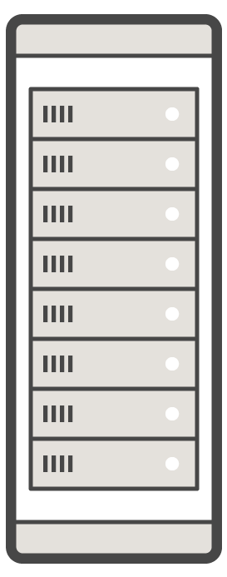


Access remote cluster resources and speed up your computations using MATLAB Parallel Server
GPU
GPU
Multi-core CPU
Multi-core CPU
MATLAB
MATLAB Parallel Server
Parallel Computing Toolbox
Prototype and develop on the desktop
Integrate with your infrastructure
Access directly through MATLAB
Notes:
Parallel Computing Toolbox and MATLAB Parallel Server allow you to easily extend your execution of MATLAB and Simulink to more resources.
In the parallel computing workflow, you start with MATLAB on the desktop, and incorporate parallel features from Parallel Computing Toolbox to use more resources. In some cases desktop parallel computing will be sufficient for your needs, and in other cases when you need to scale further, your desktop work will serve as a prototype for running on clusters and clouds. (Key features of your prototype will be robustness to being run on a computer that might not have the same file access or operating system as your computer. This type of robustness is often related to hard-coding of paths.)
When you need to scale beyond the desktop, you will need access to a cluster that has MATLAB Parallel Server installed. This might be a cluster managed by your IT department, or it could be a cloud cluster that you set up on your own with Cloud Center or a MathWorks reference architecture.
When you have access to MATLAB Parallel Server, you can use parallel resources on the cluster in the same way you did on the desktop, without needing to re-code your algorithms.

Slide 44
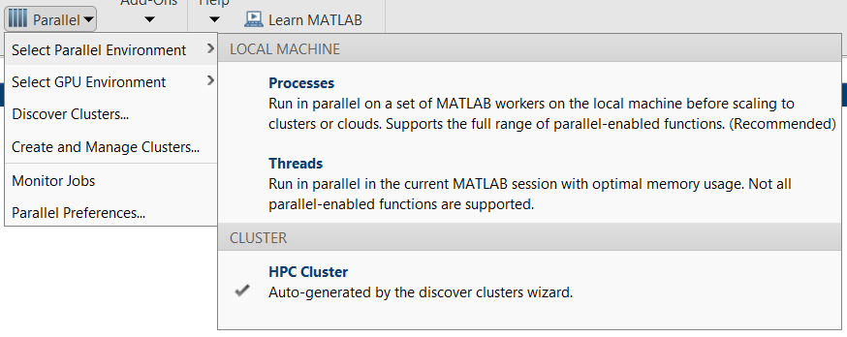
With MATLAB Parallel Server you can scale to clusters and clouds
Use more hardware with minimal code change
Submit to on-premise or cloud clusters
Support cross-platform submission
Windows client to Linux cluster
Notes:
You can select where to run your code by defining it programmatically in your code, or through the MATLAB UI, using cluster profiles. By default, you will have the local profile, which will run workers on your MATLAB client. You can create or import other profiles, which will point you to workers on remote hardware. You can have multiple profiles for access to different cluster environments, and you can submit jobs to different profiles from the same MATLAB session. You can even have an interactive parallel pool on a cluster, which is useful for debugging and prototyping. Note that your MATLAB client can only interact with one parallel pool at a time.
Parallel computing in MATLAB supports cross-platform submissions, which means that the operating system on which your MATLAB client runs can be different from the cluster operating system. Since MATLAB syntax is the same on all platforms, there is no need to rewrite your algorithms. Of course, you’ll need to ensure that your code does not use hard-coded operating-system-specific file references. Parallel Computing Toolbox includes features like additional paths and attached files that help to resolve potential issues of sharing code and data with workers on a cluster.
*next*

Slide 45
Interactive parallel computing Leverage cluster resources in MATLAB
>> parpool(myCluster,1000);
>> myScript
myScript.m:
a = zeros(N, 1);
b = pi;
parfor i = 1:length(a)
a(i) = i + b;
end
MATLAB
Parallel Computing Toolbox
MATLAB Parallel Server on HPC Cluster
Notes:
Depending on your system and network configuration, you can use workers on the cluster interactively with parpool, which is useful for prototyping and debugging. You can initiate an interactive parallel pool to your cluster programmatically with the parpool command, through the MATLAB UI, or just by running your code.
*Click*
After initiating the parallel pool, you can run your script or function, which contains parallel language features like parfor. Any parallel language command will be automatically executed on the cluster. In this case, everything inside of the par-for loop will be executed on my HPC cluster.
You can also view your interactive parallel pool session in the job monitor – this will not display the process of the script or function, but whether the interactive pool is running or not.
*next*

Slide 46
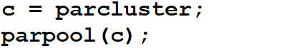
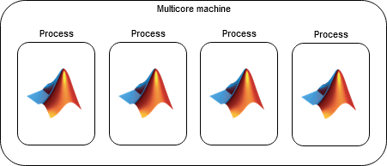
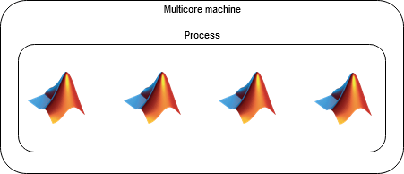
Run a parallel pool from specified profile
On local machine
Start parallel pool of local workers
Start parallel pool of thread workers
☺ Reduced memory usage, faster scheduling, lower data transfer costs
☹ Thread-based environments support only a subset of the functions available for process workers
On cluster
Start parallel pool using cluster object
mathworks.com/help/parallel-computing/choose-between-thread-based-and-process-based-environments.html
Notes:
Thread-based environment on local machine
Because thread workers can share memory, they can access numeric data without copying, so they are more memory efficient.
Communication between threads is less time consuming. Therefore, the overhead of scheduling a task or inter-worker communication is smaller.
Use this setup for reduced memory usage, faster scheduling, and lower data transfer costs.
If you choose 'threads', check that your code is supported. For more information, see Check Support for Thread-Based Environment.
To find out if you can get sufficient benefit from a thread-based pool, measure data transfer in a process-based pool with ticBytes and tocBytes. If the data transfer is large, such as above 100 MB, then use 'threads’.
Recommendation
Defaulting to process-based environments is recommended. In process-based environments, parallel language features run on workers that are backed by computing processes, which run code on cores on a machine. They differ from computing threads in that they are independent of each other.
They support the full parallel language.
They are backwards compatible with previous releases.
They are more robust in the event of crashes.
External libraries do not need to be thread-safe.
Choose thread-based environments when:
Your parallel code is supported by thread-based environments.
You want reduced memory usage, faster scheduling and lower data transfer costs.

Slide 47
batch simplifies offloading computations Submit MATLAB jobs to the cluster
>> job = batch(myCluster,"myScript","Pool",1000);
parfor
MATLAB
Parallel Computing Toolbox
MATLAB Parallel Server on HPC Cluster
Notes:
For long running jobs, you will want to transition to batch workflows, which we previously mentioned in-passing.
You can send your code using the batch command to run on remote hardware where MATLAB Parallel Server has been installed and configured. Using “batch” offloads work from your computer, so that your machine is no longer tied to the computation. That means you can do something else, put your machine to sleep, or even turn it off. By default, the command will request a single worker for serial computation, but you can include the Pool argument to request multiple workers for parallel computation.
You can submit multiple batch jobs, and the scheduler on the cluster side will schedule work as resources become available. You can check the state and progress of your job with the “State” and “diary” commands, which you can use programmatically -- through the MATLAB command window -- and interactively, through the Job Monitor. After the job has finished, you can retrieve the results in MATLAB, or view artifacts generated from the job on the filesystem of the cluster.
*next*

Slide 48
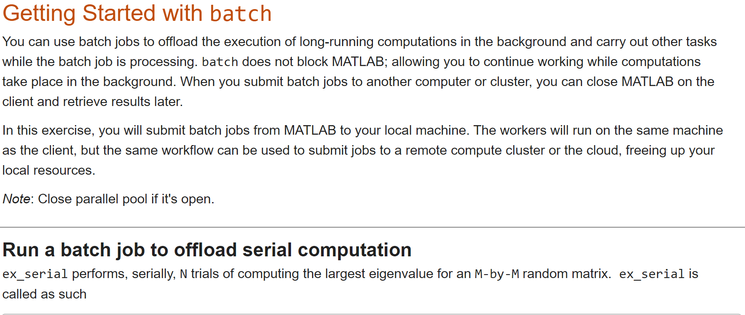
Hands-On Exercise: Use batch to offload serial and parallel computations
batch_getting_started

Slide 49

batch simplifies offloading simulations Submit Simulink jobs to the cluster
>> job = batchsim(myCluster,in,"Pool",1000);
parsim
MATLAB
Parallel Computing Toolbox
MATLAB Parallel Server on HPC Cluster
Notes:
For long running jobs, you will want to transition to batch workflows, which we previously mentioned in-passing.
You can send your code using the batch command to run on remote hardware where MATLAB Parallel Server has been installed and configured. Using “batch” offloads work from your computer, so that your machine is no longer tied to the computation. That means you can do something else, put your machine to sleep, or even turn it off. By default, the command will request a single worker for serial computation, but you can include the Pool argument to request multiple workers for parallel computation.
You can submit multiple batch jobs, and the scheduler on the cluster side will schedule work as resources become available. You can check the state and progress of your job with the “State” and “diary” commands, which you can use programmatically -- through the MATLAB command window -- and interactively, through the Job Monitor. After the job has finished, you can retrieve the results in MATLAB, or view artifacts generated from the job on the filesystem of the cluster.
*next*

Slide 50
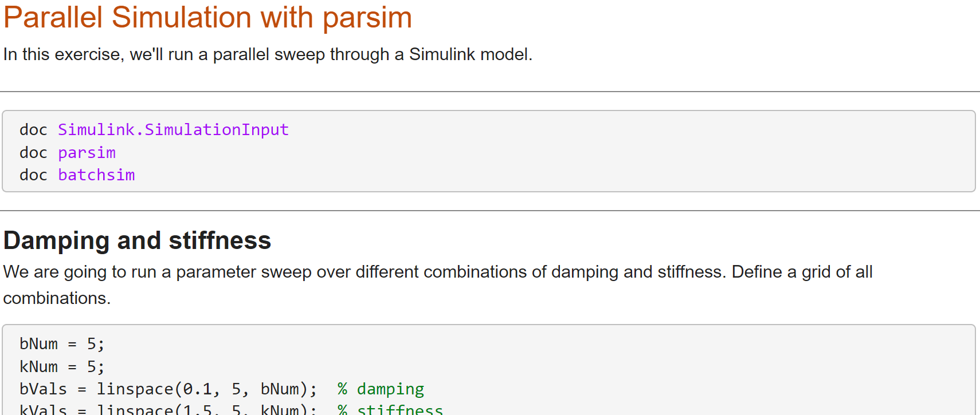
Hands-On Exercise: Parameters sweeps with Simulink
parallel_Simulink

Slide 51
Big Data . . .

Slide 52
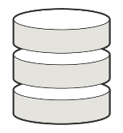


Big Data Workflows
ACCESS DATA
More data and collections of files than fit in memory
DEVELOP & PROTOTYPE ON THE DESKTOP
SCALE PROBLEM SIZE
Adapt traditional processing tools or learn new tools to work with Big Data
To traditional clusters and Big Data systems like Hadoop
Notes:
There are MATLAB capabilities customized for both beginners and power users of big data applications.
[click] You’ll be able to use constructs like datastores and tall arrays to access data that does not fit in memory, use data from a Hadoop Distributed File System (HDFS), access cloud-based storage, and create repositories of large amounts of images, spreadsheets, and custom files
While you’ll have to learn about a few more functions, they all use the same intuitive MATLAB syntax with which you’re already familiar. [click] You can prototype algorithms quickly using small data sets, and then [click] scale up -- using the same code -- to big data sets stored in and processed on large clusters.
*next*

Slide 53

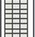

tall arrays
Data type designed for data that doesn’t fit into memory
Lots of observations (hence “tall”)
Looks like a normal MATLAB array
Supports numeric types, tables, datetimes, strings, etc.
Supports several hundred functions for basic math, stats, indexing, etc.
Statistics and Machine Learning Toolbox support
(clustering, classification, etc.)
Working with tall arrays
Notes:
Tall arrays provide a way to visualize, parse, and analyze data, even if comprised of millions or billions of rows too big to fit in your machine’s Random Access Memory (RAM). They are backed by a datastore, which is a repository of a large amount of files that are located on your machine, the cloud, or the cluster.
Many operations and functions are overloaded to work with tall arrays using the same syntax as you would use with normal, in-memory MATLAB arrays.
*next*

Slide 54
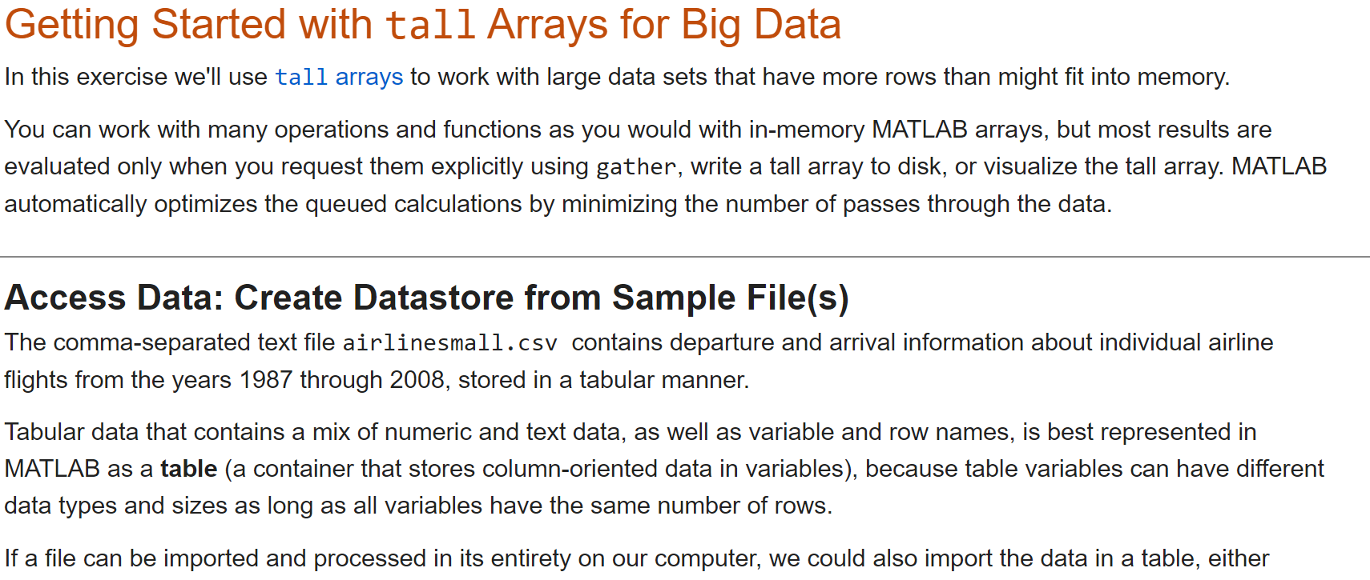
Hands-On Exercise: Use tall arrays for big data
tall_getting_started

Slide 55

distributed arrays
Distribute large matrices across workers running on a cluster
Support includes matrix manipulation, linear algebra, and signal processing
Several hundred MATLAB functions overloaded for distributed arrays
MATLAB
Parallel Computing Toolbox
11
26
41
15
30
45
20
35
50
12
27
42
16
31
46
21
36
51
13
28
43
17
32
47
22
37
52
MATLAB Parallel Server
Working with distributed arrays
Notes:
Distributed arrays are a parallel data type that uses the memory of multiple machines to store variables that are too large to store on a single machine. Using distributed arrays, you can distribute your matrices across multiple machines and go beyond the capabilities of a single computer.
You can prototype distributed array workflows on the desktop using Parallel Computing Toolbox, and then scale up to a cluster which uses MATLAB Parallel Server.
In the same spirit of trying to make things easy and simple, a large number of standard MATLAB functions work with distributed arrays using the same syntax as normal arrays, again, as overloaded functions. That means you can program a distributed-array algorithm in the same manner as an in-memory algorithm, and MATLAB will run the right version of the code based on the input data type. This enables you to take advantage of distributed computing without needing to be an expert in message passing.
*next*

Slide 56
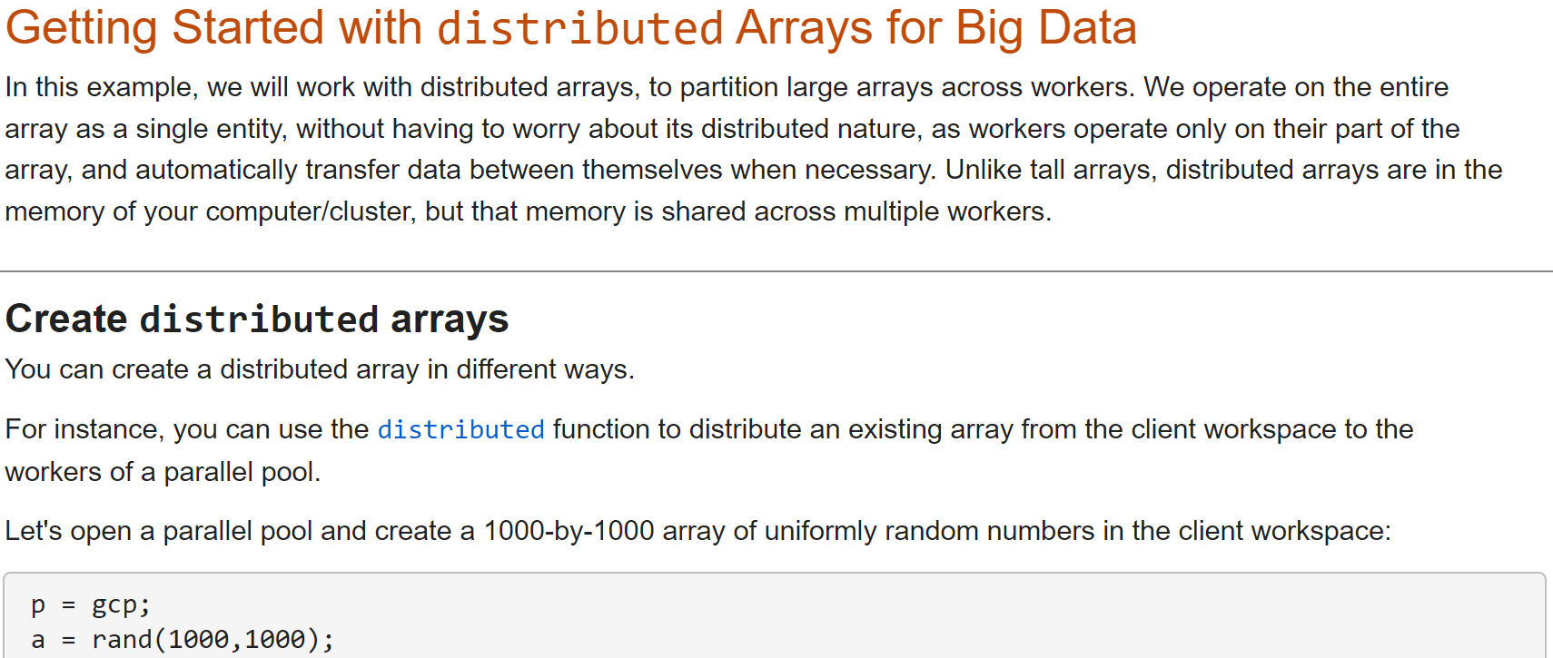
Hands-On Exercise: Use distributed arrays for big data
distributed_getting_started

Slide 57
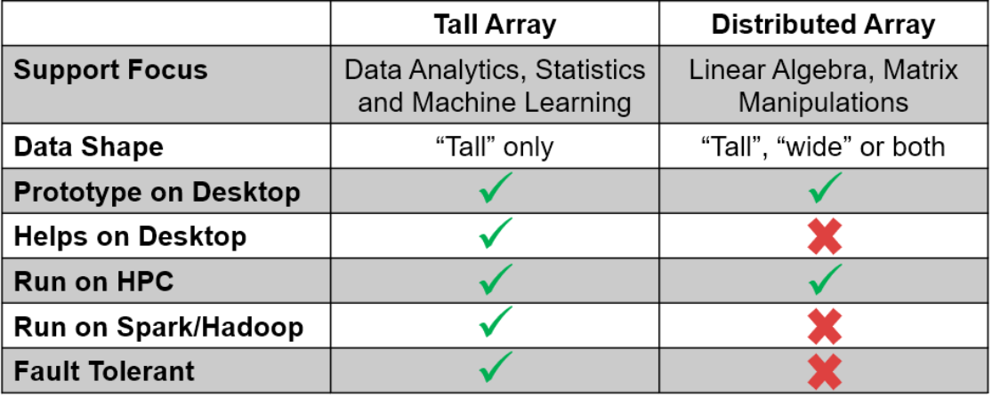
tall arrays vs. distributed arrays
tall arrays are useful for out-of-memory datasets with a “tall” shape
Can be used on a desktop, cluster, or with Spark/Hadoop
Low-level alternatives are MapReduce and MATLAB API for Spark
distributed arrays are useful for in-memory datasets on a cluster
Can be any shape (“tall”, “wide”, or both)
Low-level alternative is SPMD + gop (Global operation across all workers)

Slide 58
Scaling to clusters

Slide 59

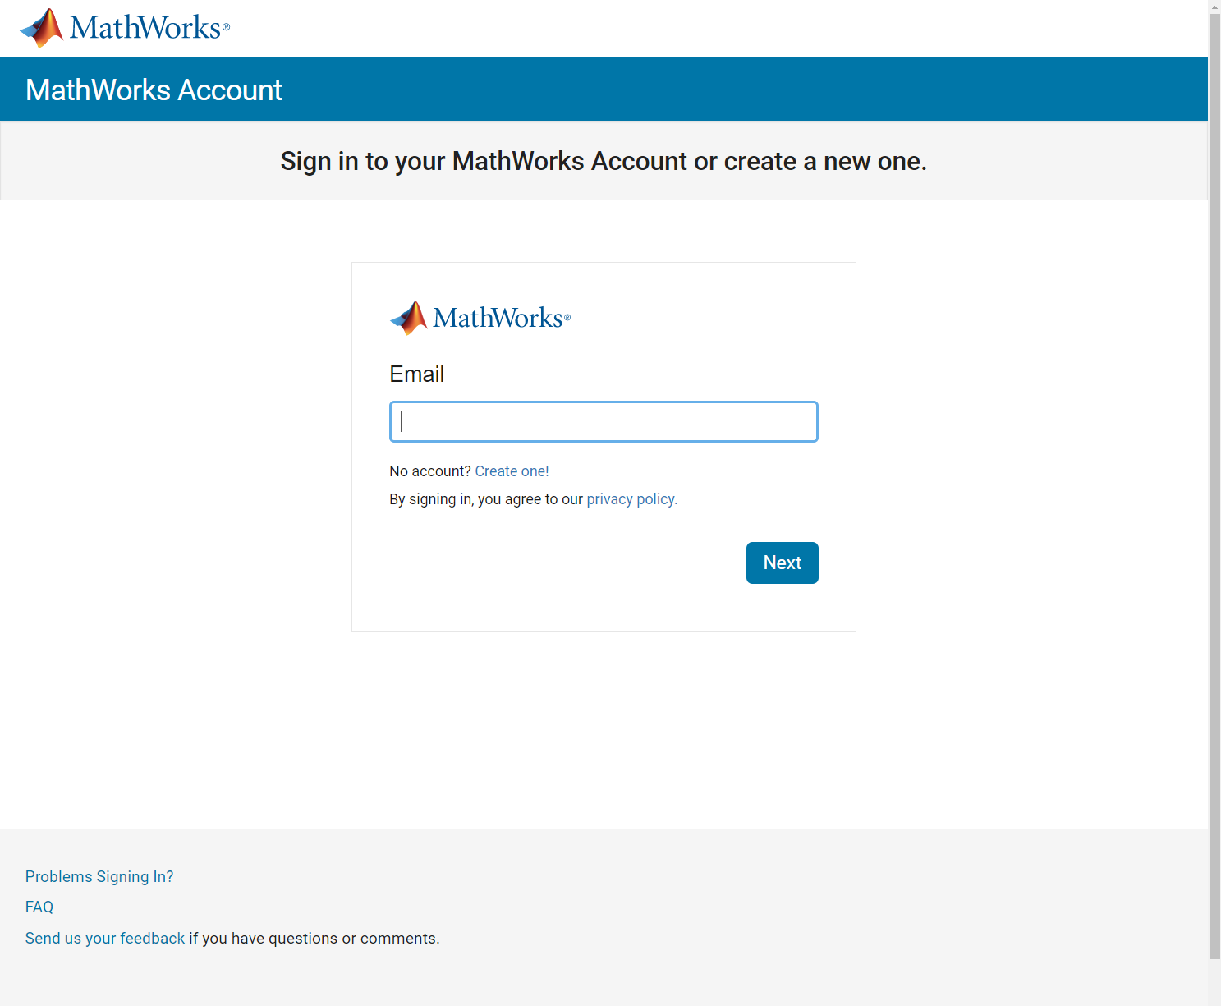
Associate to license (1)

Slide 60

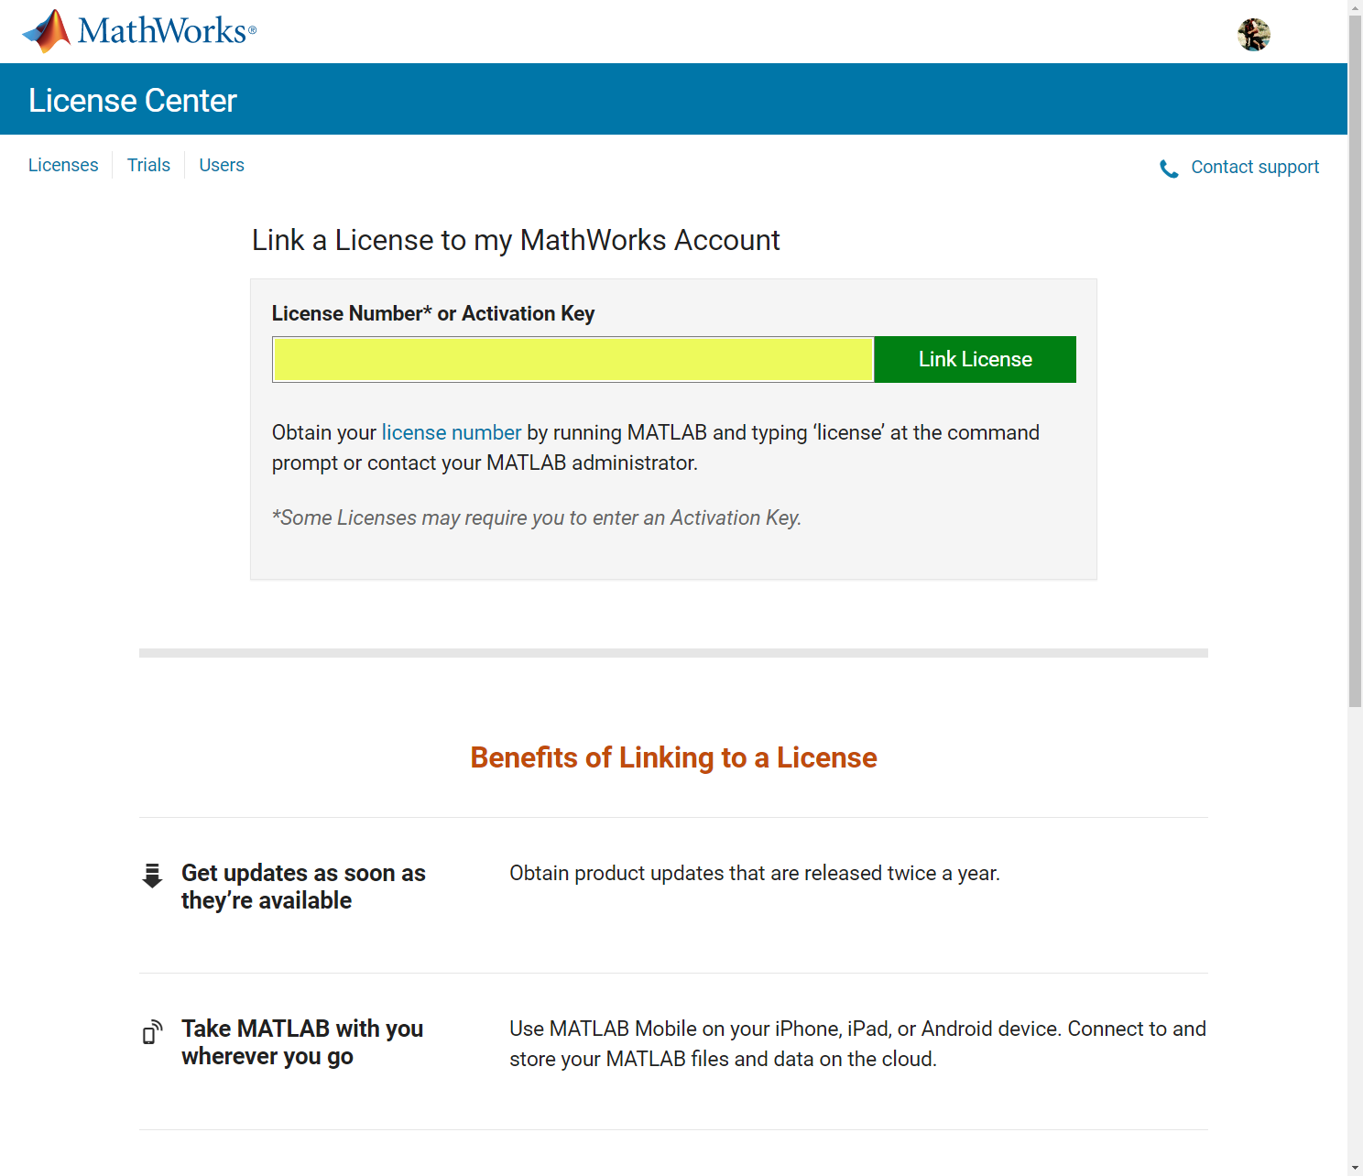
Associate to license (2)

Slide 61
66866-83413-54795-20428-84534

Slide 62
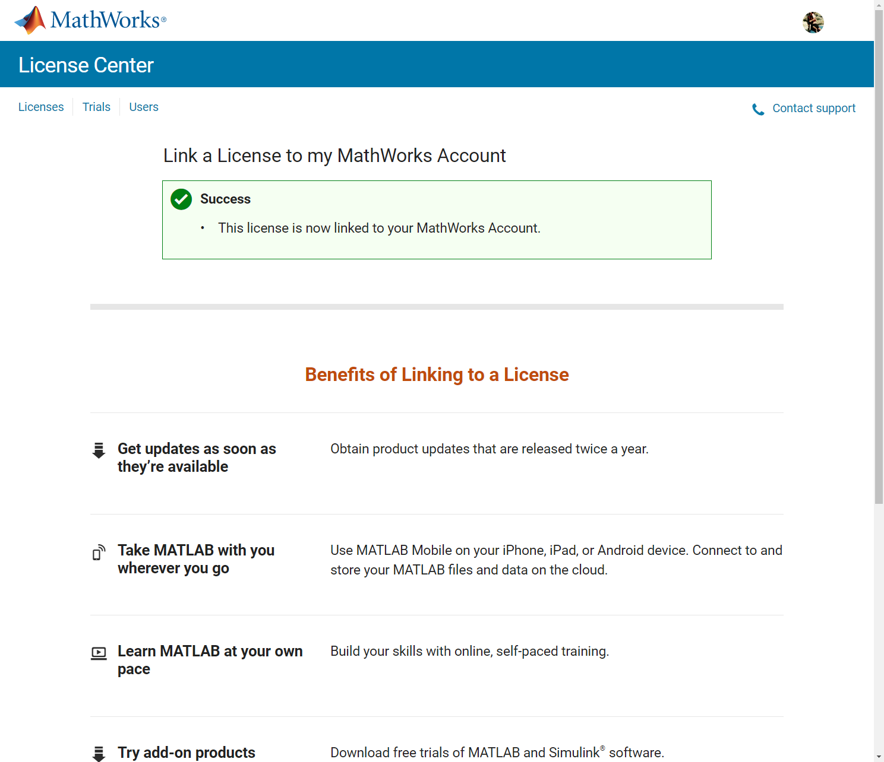
Associate to license (3)

Slide 63
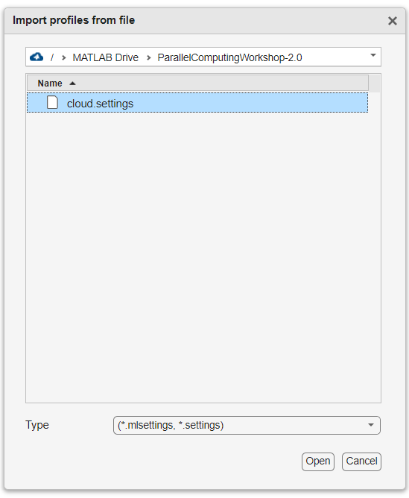
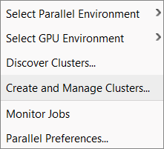
Import cloud cluster profile

Slide 64
Submit to the cloud

Slide 65
Further Resources
MATLAB Documentation
MATLAB → Software Development Tools → Performance and Memory
Parallel Computing Toolbox
Parallel and GPU Computing Tutorials
https://www.mathworks.com/videos/series/parallel-and-gpu-computing-tutorials-97719.html
Parallel Computing with MATLAB and Simulink
https://www.mathworks.com/solutions/parallel-computing.html

Slide 66

Need coding help?
https://tinyurl.com/ParallelComputingWithMATLAB

Slide 67
MATLAB and Simulink are registered trademarks of The MathWorks, Inc. See www.mathworks.com/trademarks for a list of additional trademarks. Other product or brand names may be trademarks or registered trademarks of their respective holders. © 2024 The MathWorks, Inc.

Slide 69
Extra

Slide 70
Scale further with parallel computing
MATLAB Desktop
Core 1
Core 2
Core 3
Core 4
CPU with 4 cores
Notes:
Therefore, parallel computing tools enable you to receive benefits beyond these limitations.
MathWorks offers two parallel computing tools. We alluded several times to Parallel Computing Toolbox, which we will cover now. Later, we‘ll talk about MATLAB Parallel Server.
Put another way, Parallel Computing Toolbox enables direct control of your parallel resources - control over the how you leverage your hardware resources. For example, parallel constructs like parfor let you control which portions of your workflow are distributed to multiple cores. Later on, we’ll talk about how you can extend that level of control to resources on compute clusters by using MATLAB Parallel Server.
Our parallel computing products are based on the concept of using MATLAB Workers – these are MATLAB Computational Engines or simply think of them as MATLAB sessions (without the Desktop) associated with the cores of your multicore desktop machine. A collection of these workers with inter-process communication is what we call a parallel pool.
Under the hood the parallel computing products divide the tasks/computations/simulations and assigns them to these workers in the background – enabling the computations to execute in parallel.
*next*

Slide 71
Take advantage of your multicore and multiprocessor computers automatically
with no programming effort using built-in multithreading
just by setting a flag/preference
* with Parallel Computing Toolbox
Notes:
Run MATLAB Functions with Automatic Parallel Support
Run MATLAB on multicore and multiprocessor machines
MATLAB® provides two main ways to take advantage of multicore and multiprocessor computers. By using the full computational power of your machine, you can run your MATLAB applications faster and more efficiently.
Built-in Multithreading
Linear algebra and numerical functions such as fft, \ (mldivide), eig, svd, and sort are multithreaded in MATLAB. Multithreaded computations have been on by default in MATLAB since Release 2008a. These functions automatically execute on multiple computational threads in a single MATLAB session, allowing them to execute faster on multicore-enabled machines. Additionally, many functions in Image Processing Toolbox™ are multithreaded.
It’s important to note that even without Parallel Computing Toolbox, [click] MATLAB provides implicit multi-core support with its built–in multithreading. A growing number of core MATLAB functions take advantage of underlying multi-threaded library support, and other toolboxes leverage those benefits when they use core MATLAB functions. However, not every MATLAB function is able to be multi-threaded, and any acceleration is limited to your local workstation. Another consideration is that since this happens in the background, you don’t have much control over the process.
*next*
Several MATLAB and Simulink products have a growing number of functions and features that help you take advantage of parallel computing resources without requiring any extra coding. You can enable this support by simply setting a flag or preference.
To take advantage of this functionality on your desktop, you need Parallel Computing Toolbox. Run calculations in parallel using local workers to speed up large calculations. To scale the parallel computing to larger resources such as computer clusters, you also need MATLAB Parallel Server.
Some functions run automatically in parallel by default. For example, parfor, parsim (Simulink), and tall.
Many other functions run automatically in parallel if you set an option to use parallel.
When you run a function with parallel enabled, MATLAB® automatically opens a parallel pool of workers. MATLAB runs the computation across the available workers.
Automatic parallel support starts a parallel pool of workers using the default cluster profile. If you have not touched your parallel preferences, the default profile is local. Control parallel behavior with the parallel preferences, including scaling up to a cluster, automatic pool creation, and preferred number of workers.

Slide 72
Consider parallel overhead* in deciding when to use parfor
parfor can be useful ☺
for-loops with loop iterations that take long to execute
for-loops with many loop iterations that take a short time, e.g., parameter sweep
parfor might not be useful ☹
for-loops with loop iterations that take a short time to execute
Ways to improve parfor performance:
Experiment which is faster: creating arrays before the loop or have each worker create its own arrays inside the loop (saves transfer time, especially on a remote cluster)
Use sliced variables or temporary variables
… Check
mathworks.com/help/parallel-computing/improve-parfor-performance.html
* Parallel overhead: time required for communication, coordination, and data transfer from client to workers and back
Notes:
Try
>> matlabpool ... open local 2
>> edit ... parforNestBad
>> edit ... parforNestGood
>> edit ...
parforIndependentBad
>> edit ...
parforIndependent... Good
>> edit ... parforLoopVarBad
>> edit ... parforLoopVarGood
>> edit ...
parforGlobalBad
>> edit ...
parforGlobalGood

Slide 73
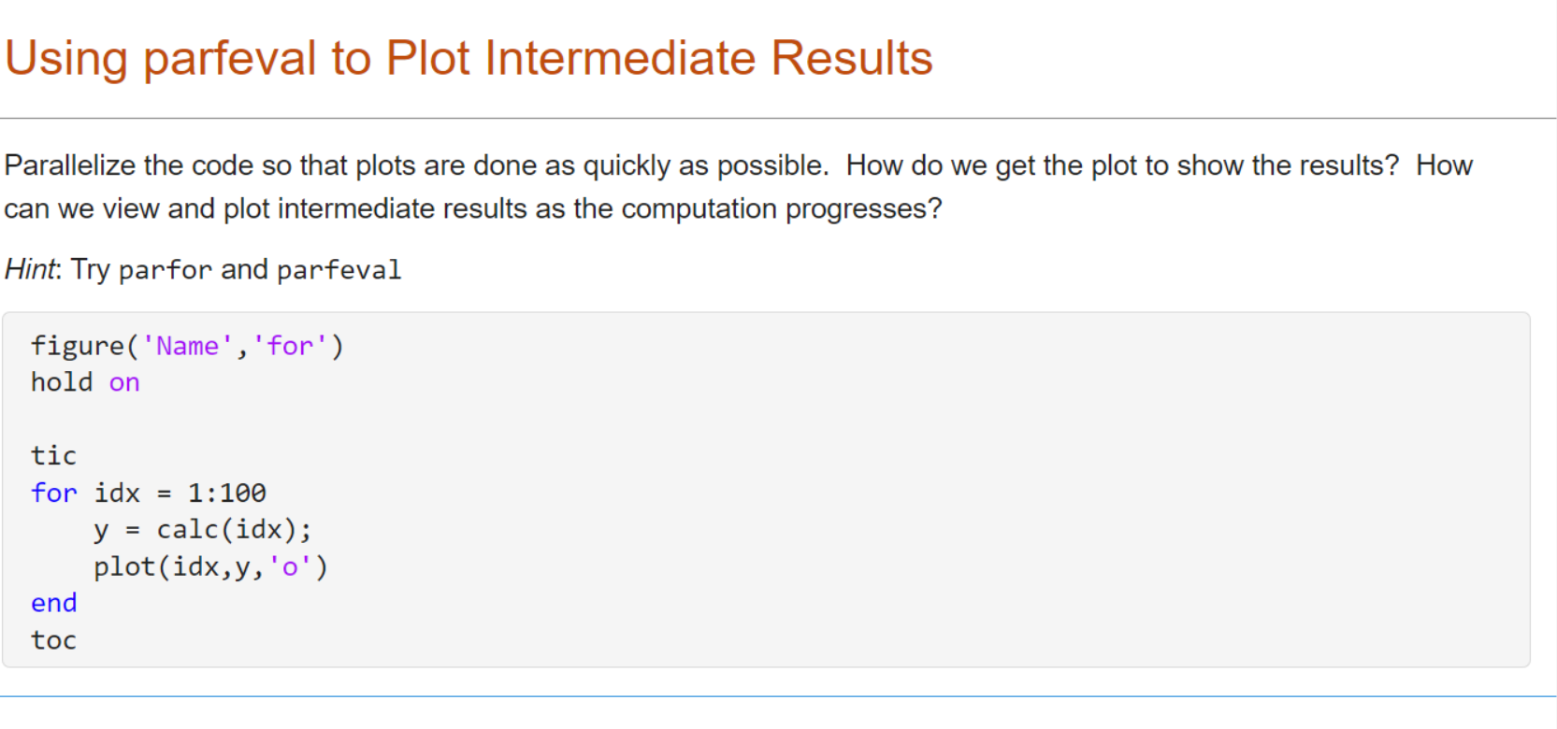
Hands-On Exercise: Use parfeval to plot intermediate results
parfeval_plotter

Slide 74
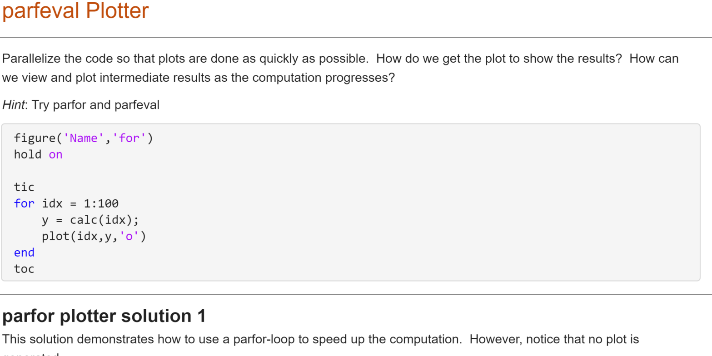
Hands-On Exercise: Use parfeval to run functions in the background
parfeval_plotter

Slide 75
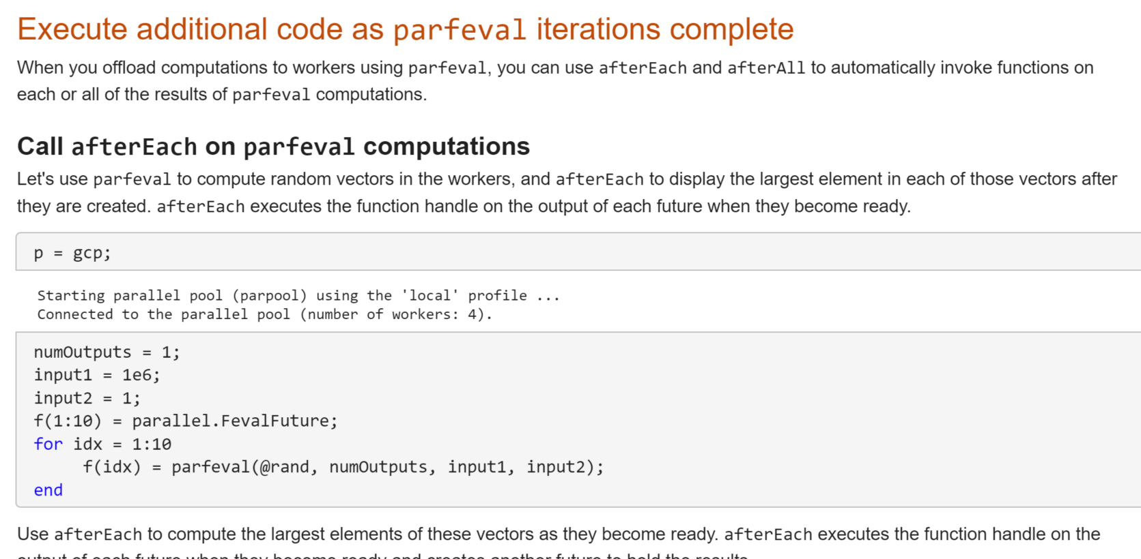
Hands-On Exercise: Use parfeval to run functions in the background
to_decide

Slide 76
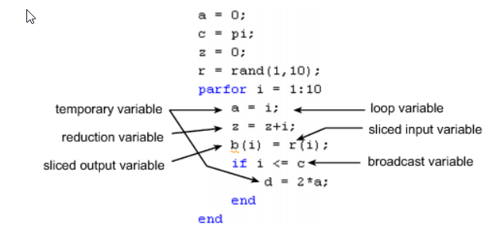
Optimizing parfor
Use more
Type | Category
sliced input | input
broadcast | input
reduction | output
sliced output | output
loop | only exist on worker
temporary | only exist on worker
Keep small
Troubleshooting variables in parfor-loops
Notes:
When MATLAB recognizes a name in a parfor-loop as a variable, the variable is classified in one of several categories, shown in the table on the right.
[click] Two variables types that can have a significant impact on your runtime are sliced variables and broadcast variables.
A sliced variable is a variable whose value can be broken up into segments, or slices, which are then operated on separately by different workers. Each iteration of the loop works on a different slice of the array. Using sliced variables can reduce the amount of required communication between the client and workers.
A broadcast variable is any variable, other than the loop variable or a sliced variable, that does not change inside the loop. At the start of a parfor-loop, the values of any broadcast variables are sent to all workers. That means that large broadcast variables can cause significant overhead in having to transfer them between the client and workers.
Therefore, [click] optimize parfor-loops by trying to use more sliced variables, and keep small any necessary broadcast variables to reduce parallel overhead.
*next*

Slide 77
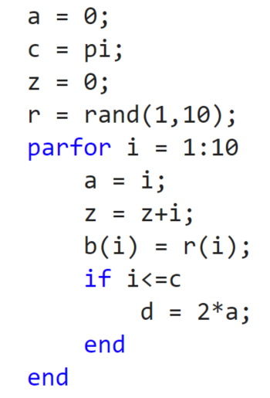








Optimizing parfor-loops
defined outside of the parfor body and thus still 0 at the end of the parfor
loop variable (loop index)
must be consecutive, increasing, integers
temporary variable (set inside the parfor body, cleared at the start of each iteration, not sent back to client)
sliced input variable (each iteration works on a different slice of the array) → reduced communication overhead from client to workers ☺
reduction variable (accumulates across all iterations in the same manner, usable after the loop)
broadcast variable (value required but not set inside the loop, sent to all workers, large variables increase communication overhead ☹)
sliced output variable reduced communication overhead from workers to client ☺
Troubleshooting variables in parfor-loops
Notes:
When MATLAB recognizes a name in a parfor-loop as a variable, the variable is classified in one of several categories, shown in the table on the right.
[click] Two variables types that can have a significant impact on your runtime are sliced variables and broadcast variables.
A sliced variable is a variable whose value can be broken up into segments, or slices, which are then operated on separately by different workers. Each iteration of the loop works on a different slice of the array. Using sliced variables can reduce the amount of required communication between the client and workers.
A broadcast variable is any variable, other than the loop variable or a sliced variable, that does not change inside the loop. At the start of a parfor-loop, the values of any broadcast variables are sent to all workers. That means that large broadcast variables can cause significant overhead in having to transfer them between the client and workers.
Therefore, [click] optimize parfor-loops by trying to use more sliced variables, and keep small any necessary broadcast variables to reduce parallel overhead.
*next*

Slide 78

Hands-On Exercise: Variables in parfor-loops

